Slide 1
CommandBridge™ Situation Awareness & Response
Overview
March 29, 2013

Slide 2
Mariner
The US Market Leader in Maritime Domain Awareness & Response
Developers of CommandBridge™
Focus on the Effective Combination of Security, Operations, and Regional Collaboration
Rapid Deployment / Success

Slide 3
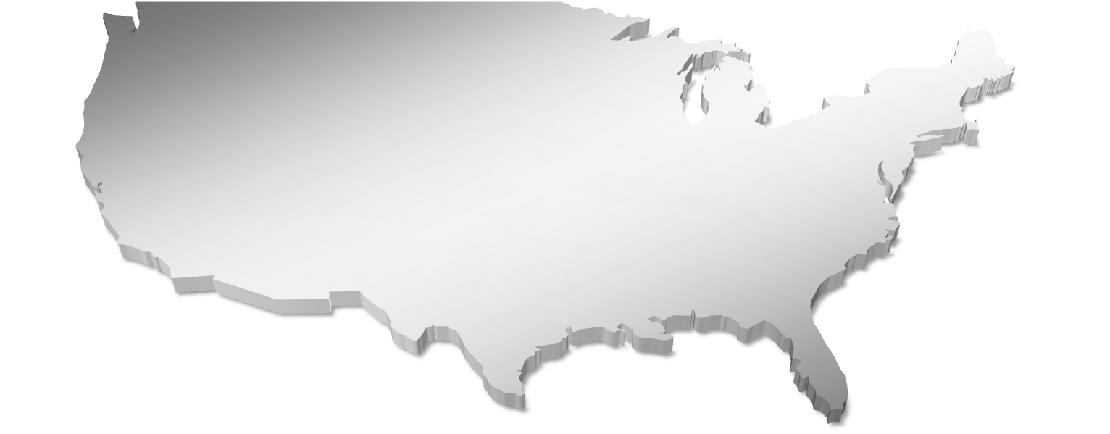
CommandBridge™
United States Installations

Slide 4
CommandBridge™ Maritime Situation Awareness & Response
US Coast Guard Sector Los Angeles / Long Beach.

Slide 5
CommandPost™
Mobile Use of CommandBridge
View All the Same Tracks/Zones
Post Brief Status Messages
WiFi or 4G Connection

Slide 6
Architecture
Based on .NET Framework
Microsoft Silverlight
Windows Security Model
Role Based Authentication
Security
DISA Gold Disk
USCG TISCOM

Slide 7
Security Benefits
Broad-based Situation Awareness & Response
Across Geographic Boundaries
Across Intermodal Transportation Routes
Across Facilities
Configurable Platform
Tailored by Organization / Position / User
Rule-Based
Increase Awareness
Decrease Clutter
Focus on Mission
Actionable
Standard Operating Procedures
Task Response Assets
Logistics Planning

Slide 8
Operational Benefits
Zone Monitoring
Every Entry / Loiter / Exit
Integration to ERP/Billing Systems
Situation Replay
Verification of Entire Situation
Verification Times & Situations
Export Capabilities
State of the Company
Temporal View of Past/Current/Future Activity
Planning Tool

Slide 15
Mainstreaming of Situation Awareness
Convergence
Geospatial Technology
Location Services
Ubiquitous Infrastructure
Ubiquity
Situation Awareness
Anywhere
Mobility Phones
Tablets
Vehicles
Specialty Devices
Social Nets Massive Adoption
Drive for Meaningful Apps
True Connected Environment
Connected
Notes:
15

Slide 16
Demonstration
CommandBridge™

Slide 17
Questions?

Slide 18
Contacts
Erin Phelps
The Mariner Group, LLC
1301 Gervais Street, Suite 502
Columbia, SC 29201
703-965-9397
ephelps@themarinergroup.net
Steve Dryden
The Mariner Group, LLC
1301 Gervais Street, Suite 502
Columbia, SC 29201
803-530-9001
sdryden@themarinergroup.net

